Slide 1
ITS Java course
Java Fundamentals

Slide 2
What is Java and the history behind it:
It’s been 25 years since Java set our world spinning with new possibilities.
Java is a widely popular, high-level, object-oriented programming language
Originally developed by James Gosling at Sun Microsystems (1991)
Initially, Gosling named the language “Oak” after an oak tree outside his office. However, due to trademark issues, the team later renamed it “Java,” inspired by their love for coffee.
Java’s “Write Once, Run Anywhere” (WORA) philosophy was a significant breakthrough.
https://medium.com/@AlexanderObregon/a-journey-through-time-the-history-of-java-programming-language-9b285d139333

Slide 3
“Write Once Run Everywhere”
Java is a programming language that produces software for multiple platforms.
When a programmer registers a Java application, the compiled code (known as bytecode) runs on most operating systems, including Windows, Linux and Mac OS.

Slide 4
“Write Once Run Everywhere”
Java is architecture neutral, Java programs are portable
Java Program
Javac (Compile)
Byte Code
JVM
JVM
JVM
Windows
MacOs
Linux

Slide 5
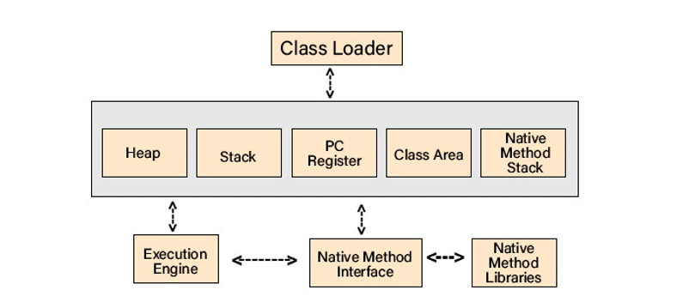
The JVM (Java Virtual Machine)
JVM (Java Virtual Machine) acts as a run-time engine to run Java applications.
A programmer can develop Java code on one system and can expect it to run on any other Java-enabled system without any adjustment. This is all possible because of JVM.
The main components of the JVM:
The garbage collector: responsible for automatically managing memory in Java applications
The classloader: responsible for loading classes and resources into memory
The execution engine: responsible for executing Java bytecode, which is the intermediate representation of Java source code.

Slide 6
The advantages of the JVM
Java programs compiled to bytecode can run on any platform with a compatible JVM. This "Write Once, Run Anywhere" capability makes Java a versatile choice for cross-platform development.
Automatic Memory Management: The JVM includes a garbage collector that manages memory, automatically deallocating objects that are no longer in use. This simplifies memory management and reduces the risk of memory leaks.

Slide 7
The disadvantages of the JVM
JVM-based applications can be memory-intensive
Java applications may have slower startup times compared to natively compiled languages.
Lack of Low-Level Hardware Control

Slide 8
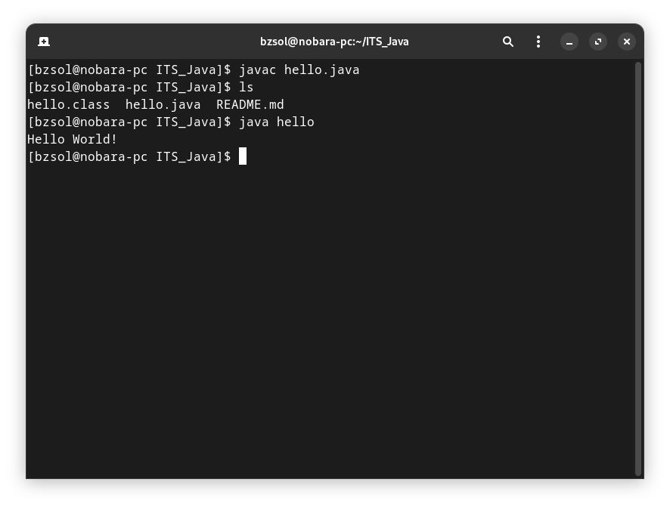
Run and compile Java programs from command line
Compile with javac hello.java command
Run the file with java hello
It generates a hello.class file
For Windows machines you have to add the JDK bin folder to your PATH
set path=C:\jdk21\bin
(or your path where you located the JDK)

Slide 9
Install JDK (Java Development Kit)
The Oracle Java (Oracle proprietary builds):
https://www.oracle.com/java/technologies/downloads/
The OpenJDK:
https://jdk.java.net/21/
Azul JDK:
https://www.azul.com/downloads/?package=jdk#zulu
And many more JDK build….

Slide 10




Top IDEs for Java Development
Visual Studio Code - But that one is not an IDE
Eclipse
IntelliJ
Apache NetBeans IDE

Slide 11
Data Types and Variables

Slide 12
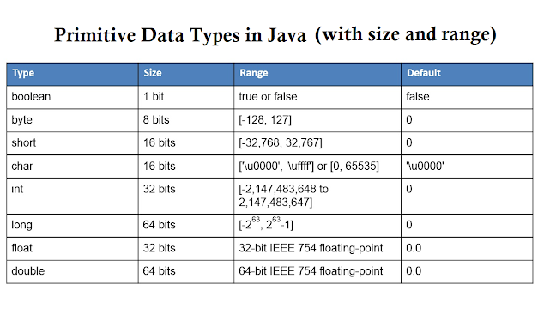
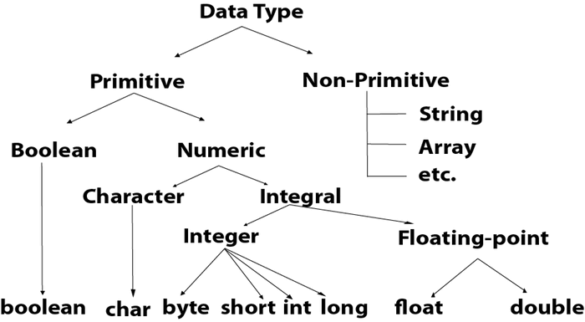
Data types
A variable in Java must be a specified data type!
There are two data types: Primitive and Non-Primitive

Slide 13
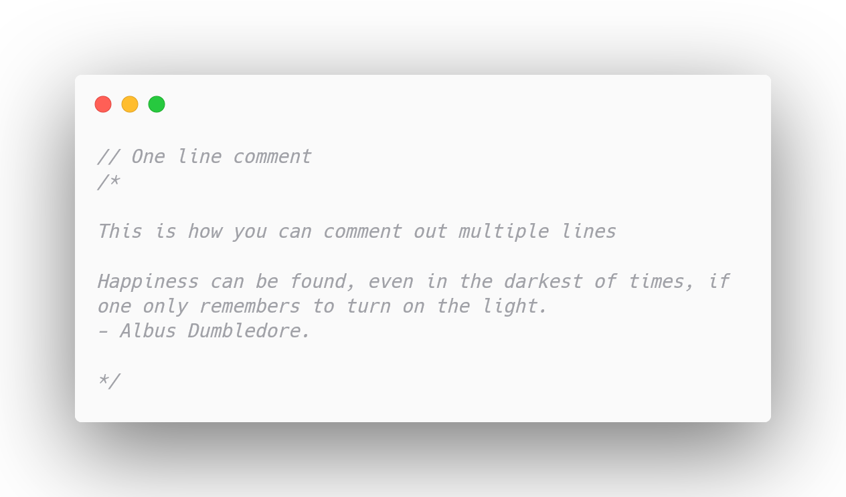
Comments
We use comments all the time to document our code, or explain something in the Java code. The goal is to make it more readable. It is also useful to comment out some code when you want to test it.

Slide 14
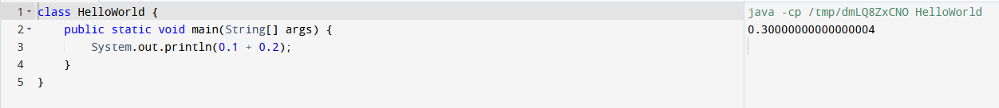
Why float data types are not precise
“Floating-point decimal values generally do not have an exact binary representation. This is a side effect of how the CPU represents floating point data. For this reason, you may experience some loss of precision, and some floating-point operations may produce unexpected results.”
https://learn.microsoft.com/en-us/cpp/build/why-floating-point-numbers-may-lose-precision?view=msvc-170

Slide 15
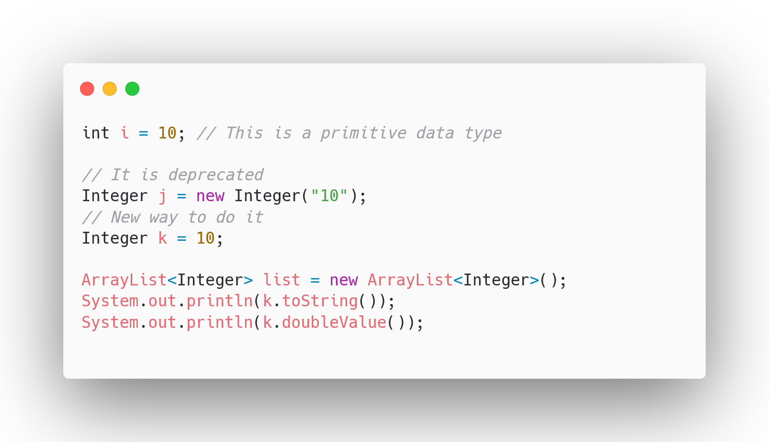
Wrapper data types
Wrapper classes provide a way to use primitive data types as Objects.
It is essential when we want to use them for Search, Sorting or for Collections such as ArrayLists or any kind of Data Structure in Java.

Slide 16
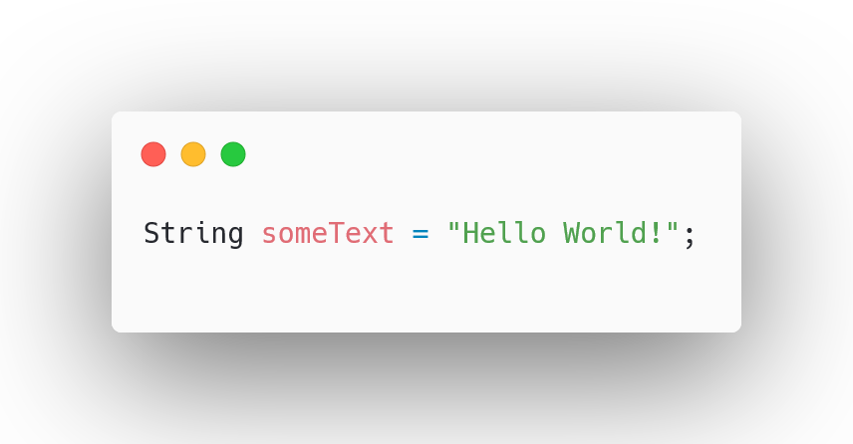
String variable - String class
Generally, String is a sequence of characters. But in Java, string is an object that represents a sequence of characters. (Key knowledge Object type starts with a capital letter!)
A string is immutable so cannot be changed!
Java String class provides a lot of methods to perform operations on strings.

Slide 17
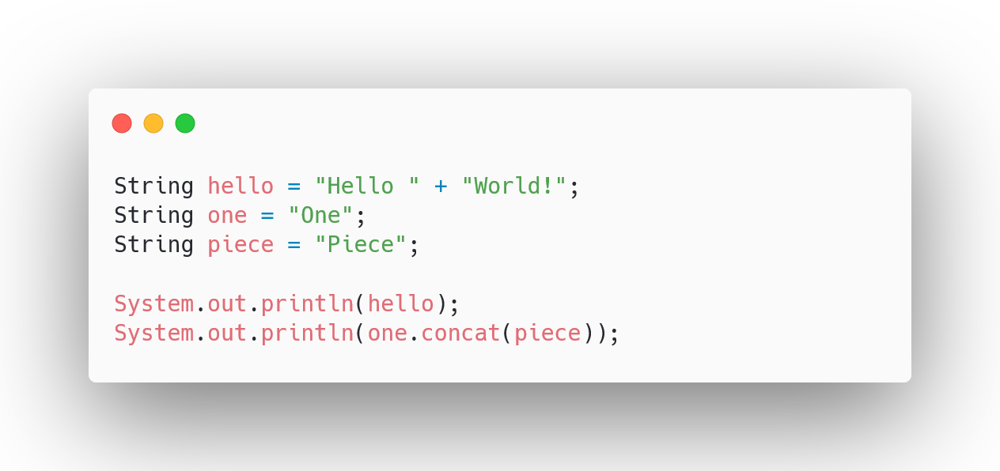
How to format our Strings and Outputs
There are a lot of ways to format our strings and the output.
One of the most common concatenation approaches in Java is using the + operator. But we can use the concat() method, but be advised the concat() is immutable

Slide 18
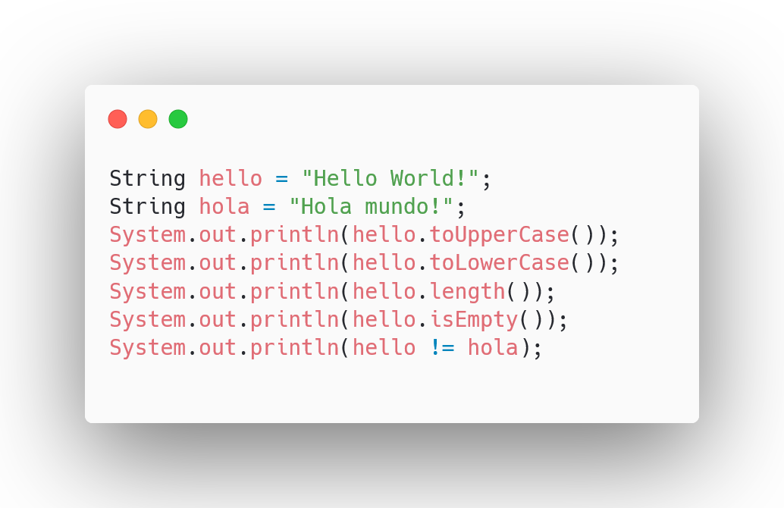
Some useful methods for Strings
There are a lot of methods that can be useful when we work with Strings such as toUpperCase() , toLowerCase() , length()...

Slide 19
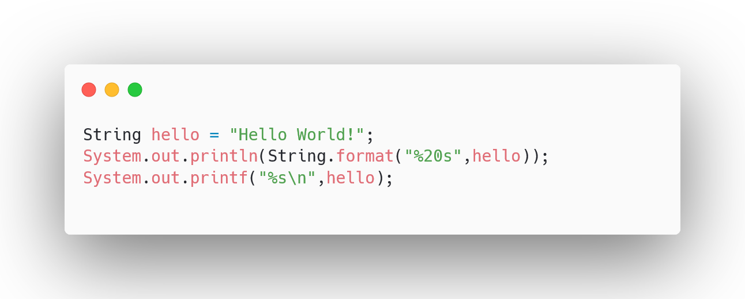
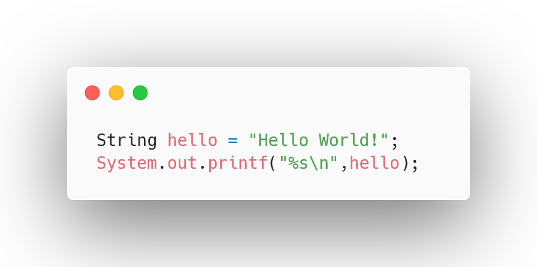

Format the output with printf
Java uses the similar syntax to output strings like in the C language printf, if you want to print out a string %s is the symbol we state that there’s a string value there. For decimal numbers we can use %d for example.
The %20s represents that you can add 20 whitespace before print out the string valie

Slide 20
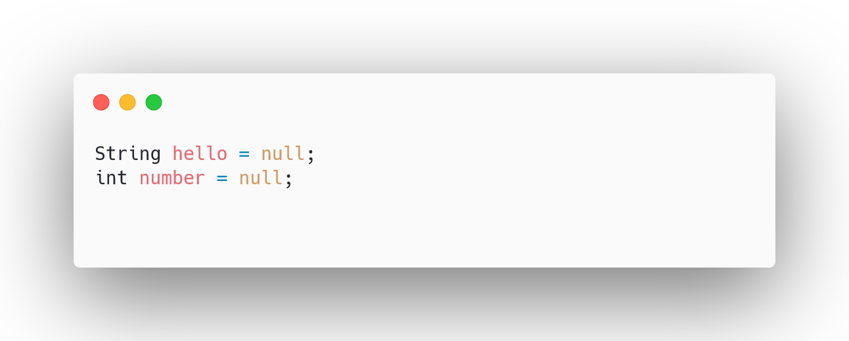
NULL data type
In Java, null is a special value that represents the absence of a value or reference.
It is essentially a way to indicate that a reference variable does not currently point to any object or value in memory.

Slide 21
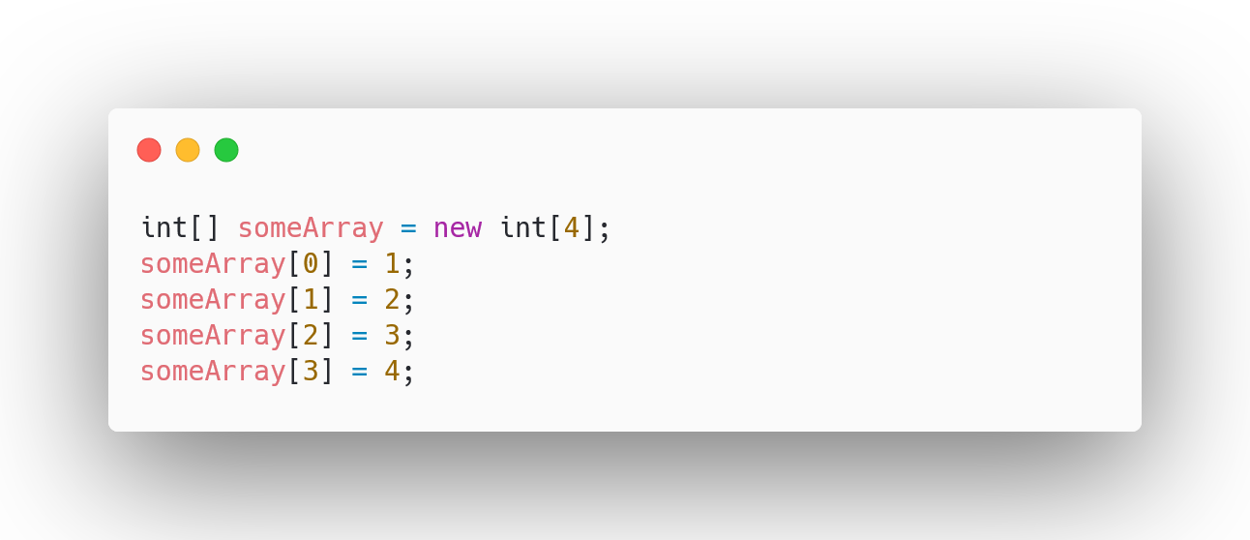
Arrays
In Java, an array is a data structure used to store a collection of elements of the same data type. These elements are stored in contiguous memory locations, and each element in the array is accessed by its index. The index is an integer value that represents the position of the element within the array, starting from 0 for the first element. (REALLY IMPORTANT)

Slide 22
Conditions in Java

Slide 23
What is our main goal
As programmers, we are in control of every action a computer carries out.
Conditions are statements that are created by the programmer which evaluates actions in the program and evaluates if it's true or false.

Slide 24
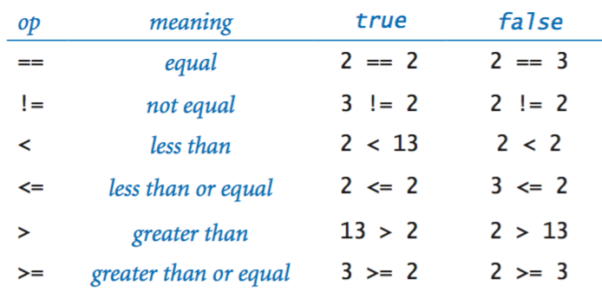
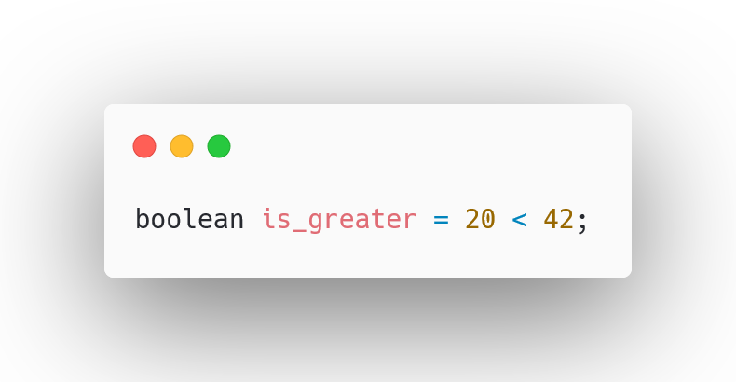
Java and compare operations - boolean Values
It is essential to compare values in any kind of situation, so Java offers 6 compare operators
Boolean values store only two values.
true / false

Slide 25
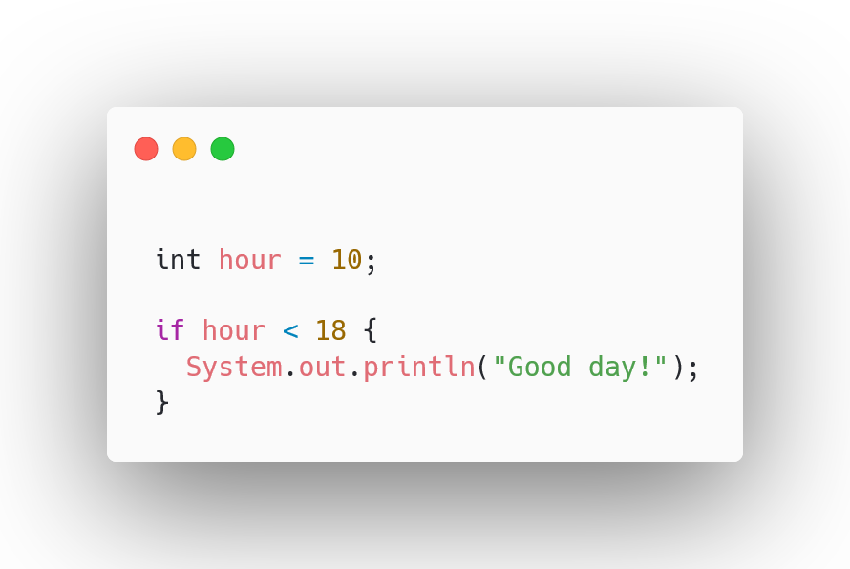
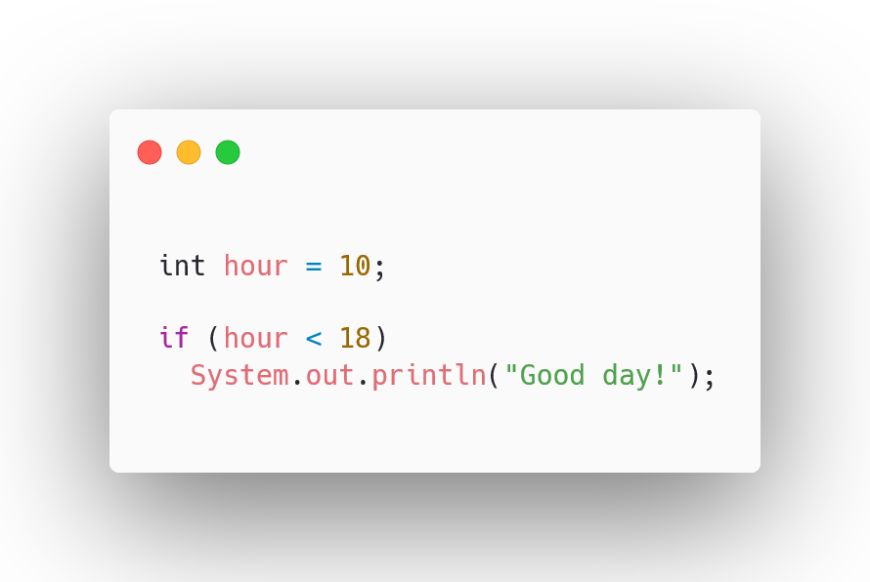
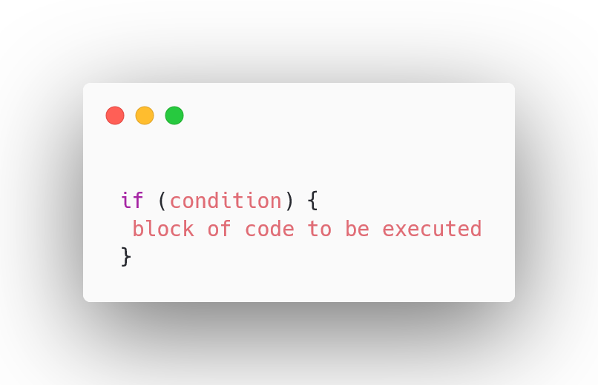
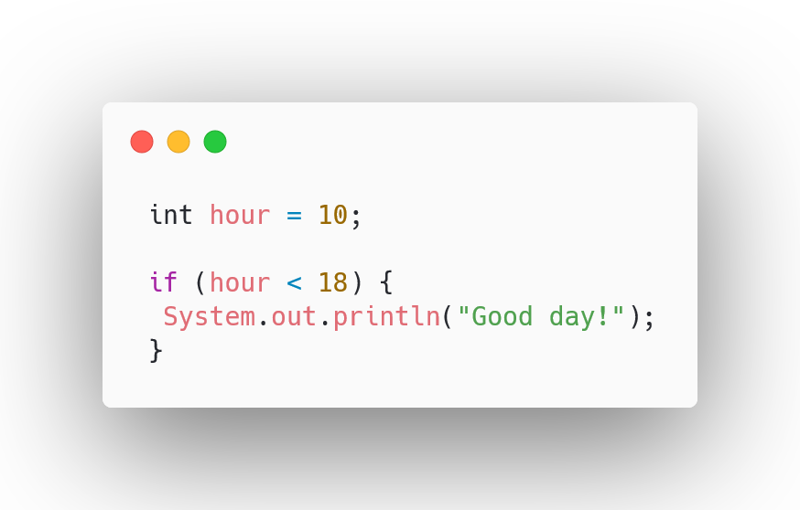
The If statements
Very often when you write code, you want to perform different actions for different decisions.
We use if, if we want to specify a block of code to be executed.

Slide 26
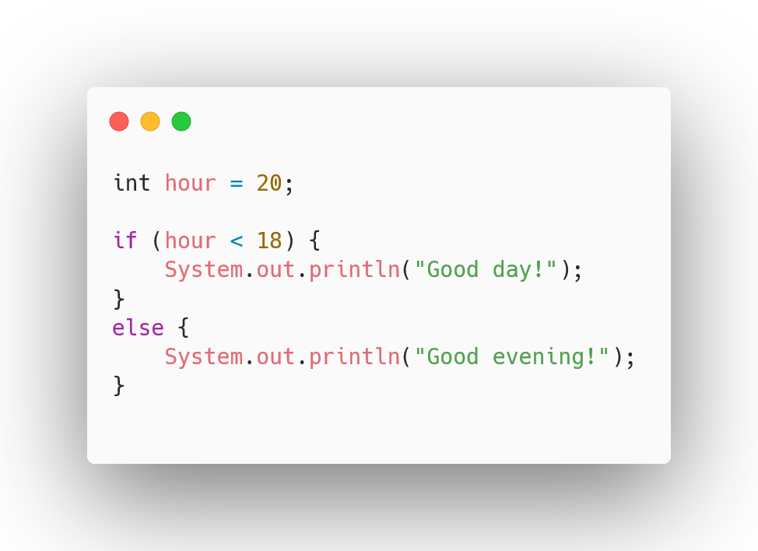
The If…Else statements
We use the else statement to specify a block of code to be executed if the condition is false.

Slide 27
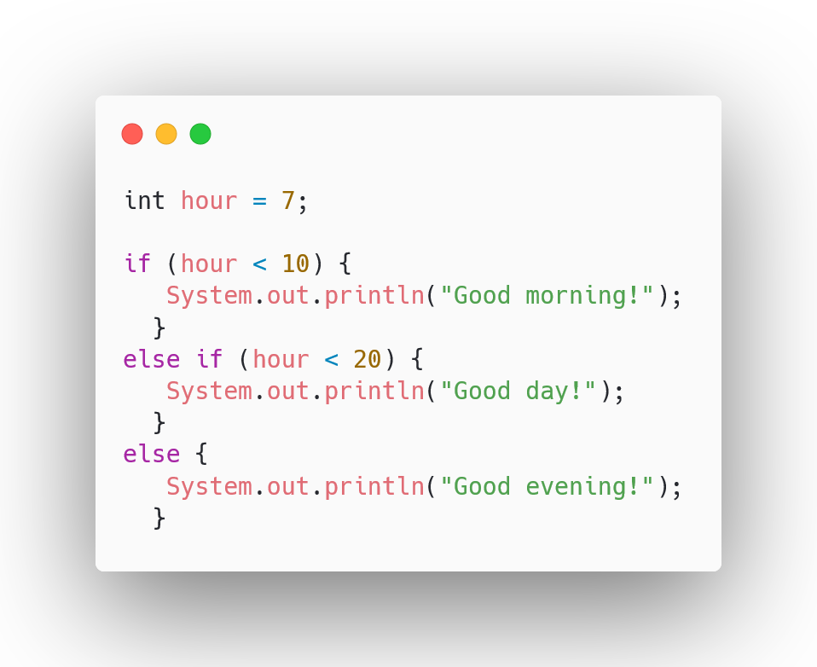
Else If statement
Use else if to specify a new condition if the first if condition is false.

Slide 28
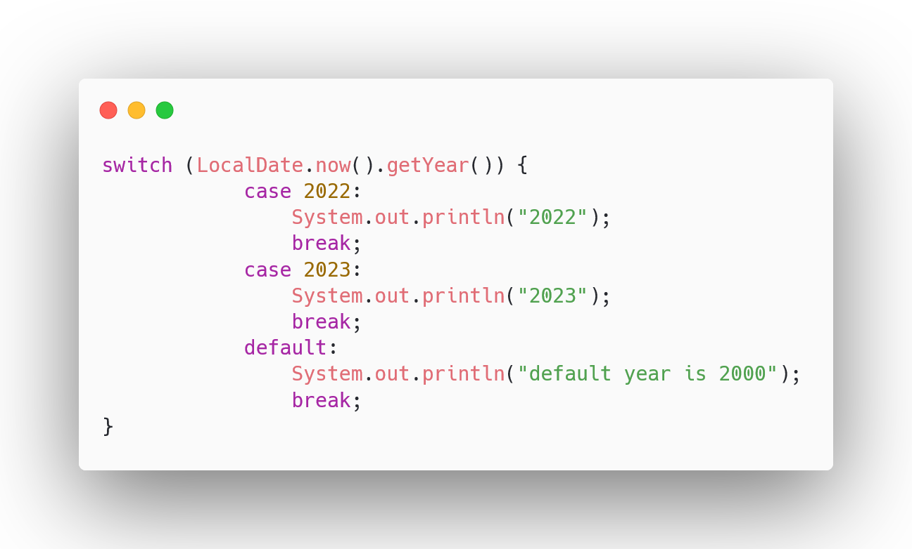
The switch statements
Usually consider to use switch case if you want to select one of many code blocks to be executed, also it’s more readable and much more cleaner to use.

Slide 29
The switch statements
The default clause of a switch statement will be jumped to default, if no case matches the expression's value. (It is optional)
You can use the break statement within a switch statement body to break out early, often when all statements between two case clauses have been executed.
If we don’t put a break after our case, it continues to check the cases, this behavior is called "fall-through".

Slide 30
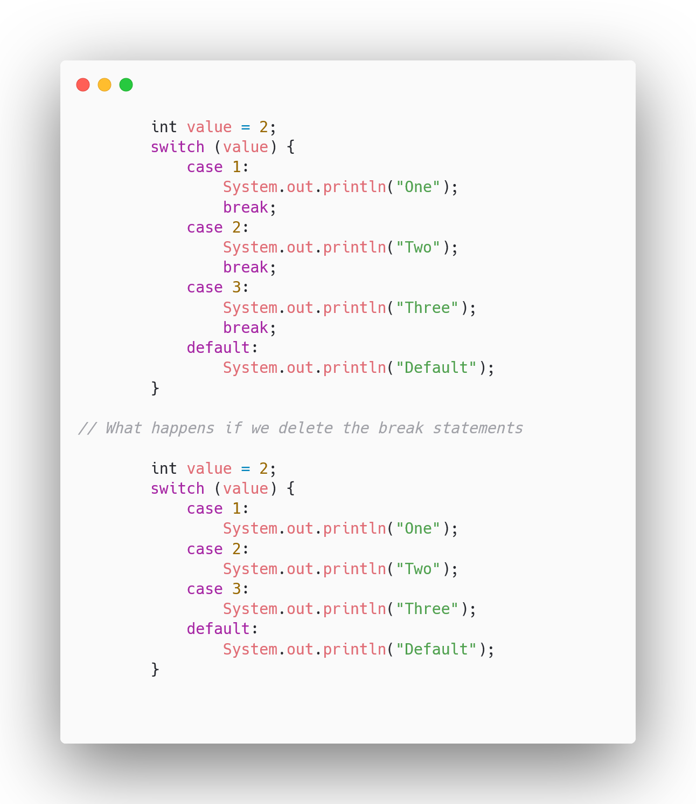
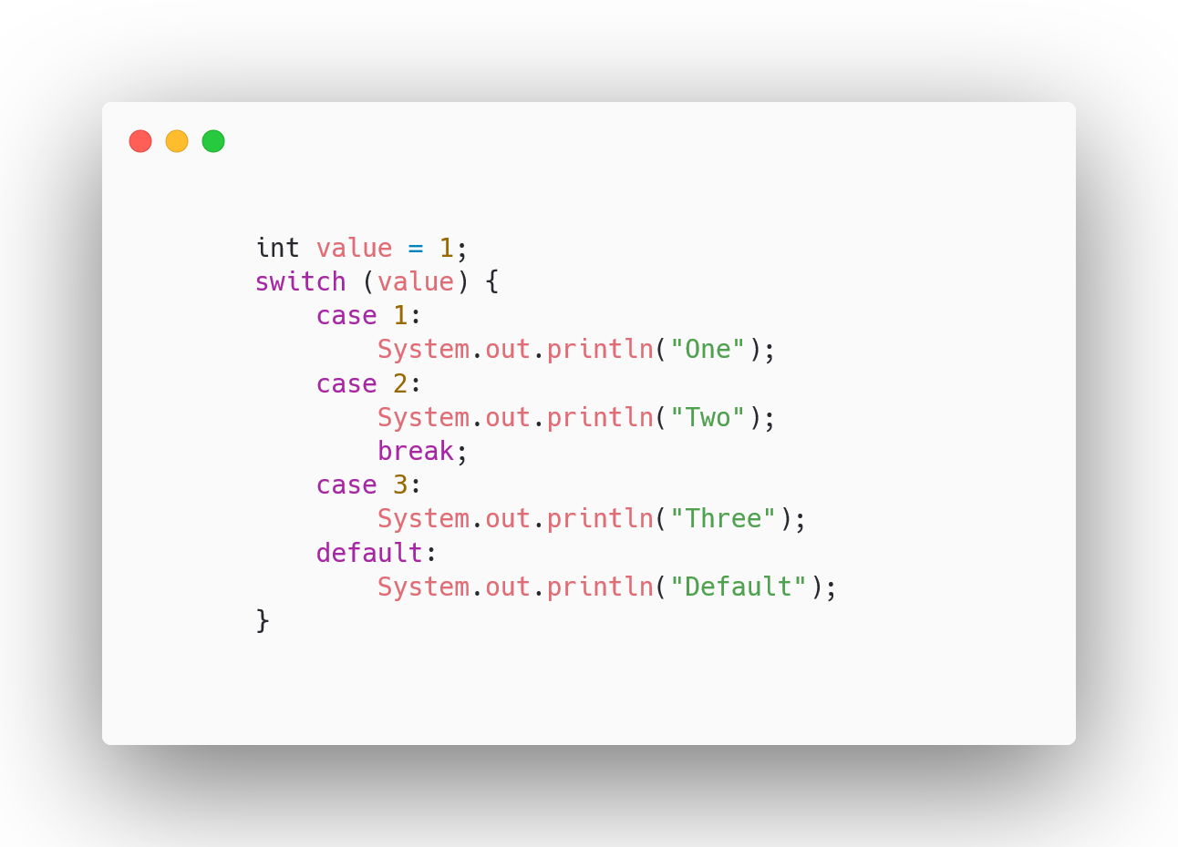
The switch case practice:

Slide 31
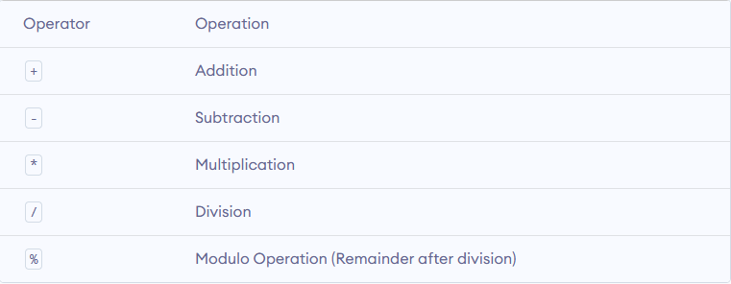
Arithmetic Operators

Slide 32
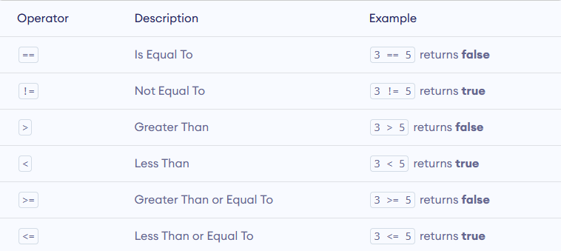
Relational operators

Slide 33
Logical operators in Java
Logical operators are used to perform logical operations.
Logical operators can be defined as a type of operators that help us to combine multiple conditional statements.
We learn some of them like AND, OR , XOR (Exclusive OR) and NOT

Slide 34
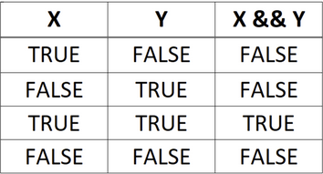
AND logical operator
(5 > 3) && (2 < 10) == True / False?
(10 > 1) && (3 > 6) == True / False? (5 < 3) && (3 == 3) == True / False?

Slide 35
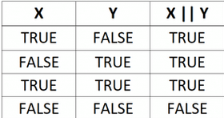
OR logical operator
(7 < 5) || (8 < 11) == True/False? (3 > 9) || (4 < 3) == True / False?
(6 == 6) || (2 > 1) == True / False?

Slide 36
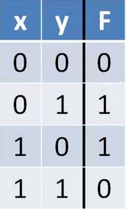
XOR operator
(3 > 5) ^ (8 == 8) == True/False? (8 > 5) ^ (5 < 10) == True/False?
(6 > 3) ^ (5 < 6) == True/False?

Slide 37
NOT logical operator
The NOT operator is written with an exclamation point (!)
The NOT operator makes a true statement false, and a false statement true:
!true = false
!false = true

Slide 38
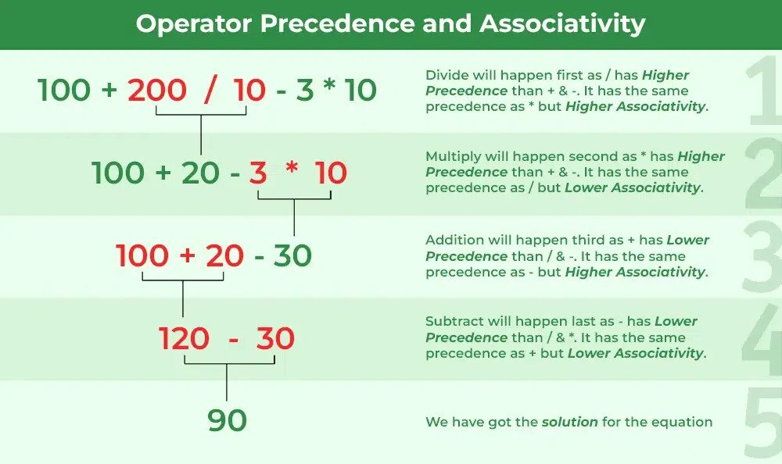
Operators precedence and associativity
An easy way to remember the operator precedence is to remember the word PEMDAS, which is an acronym for: parentheses, exponents, multiplication, division, addition, subtraction.
()
5 ^ 3
2 * 6
6 / 3
4 + 8
5 - 7

Slide 39
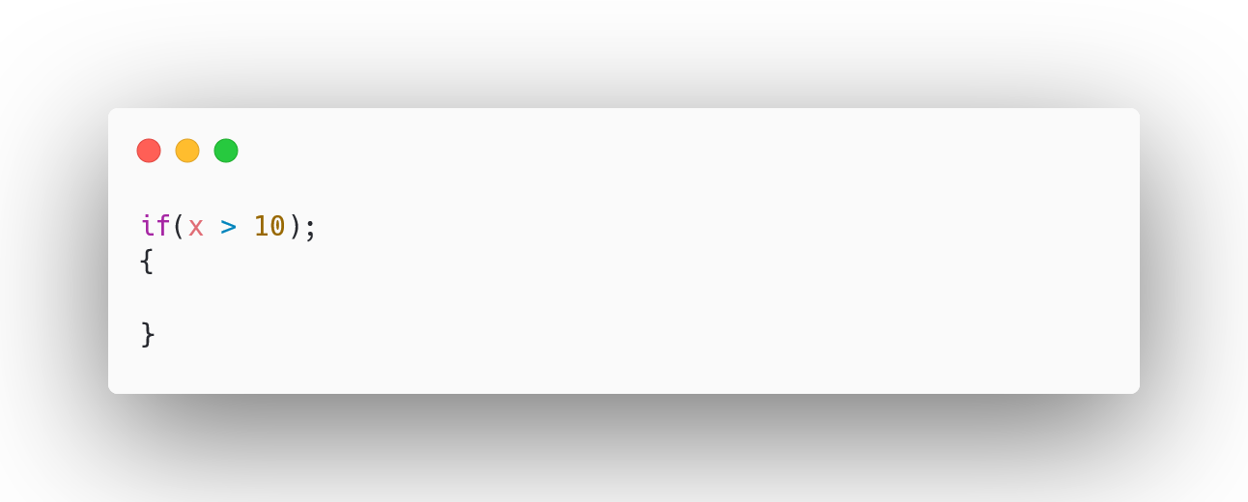
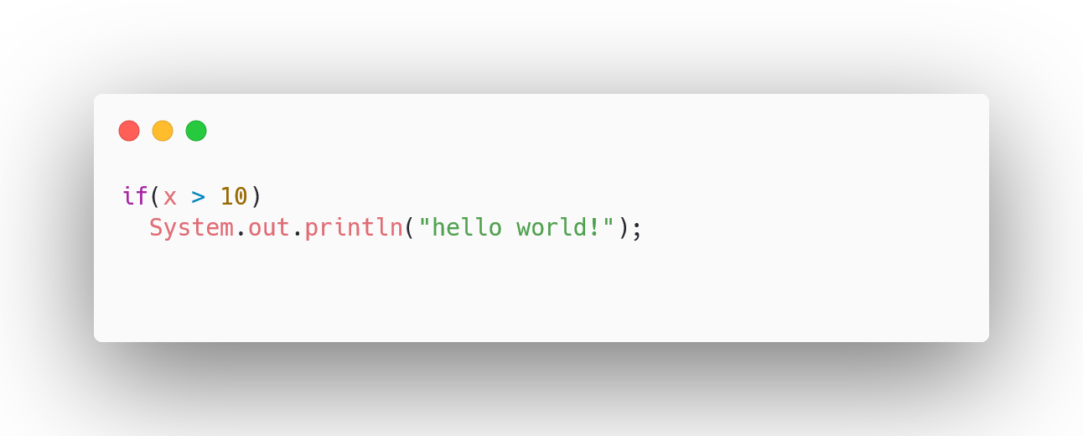
Frequently committed mistakes
It’s valid but that can lead to mistakes!

Slide 40
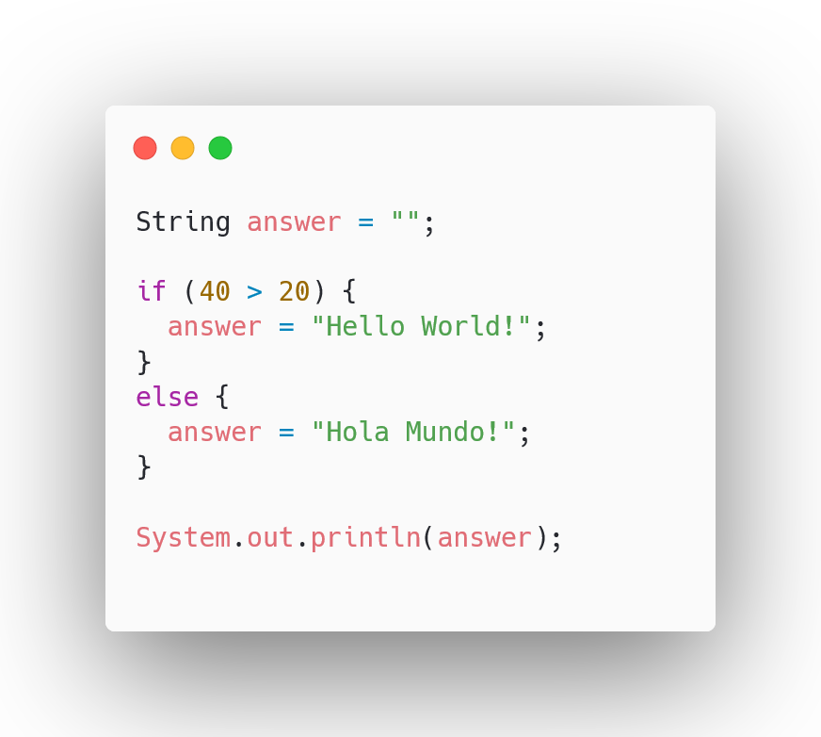
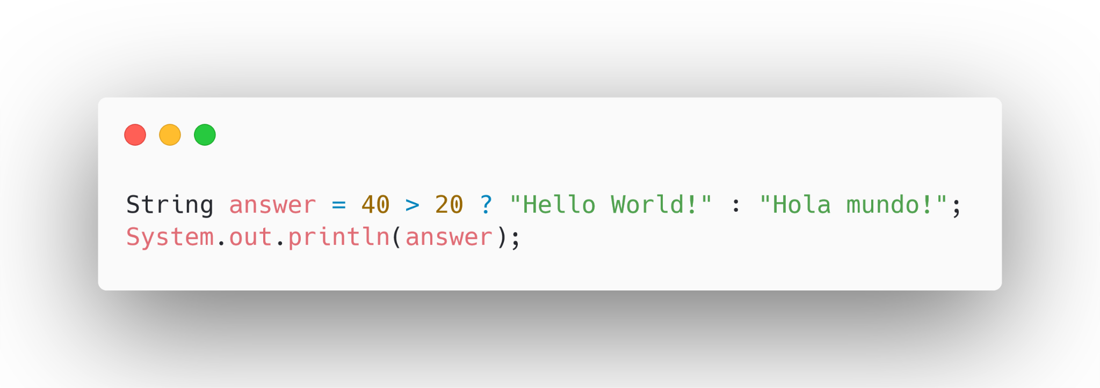
Conditional (ternary) operator

Slide 41
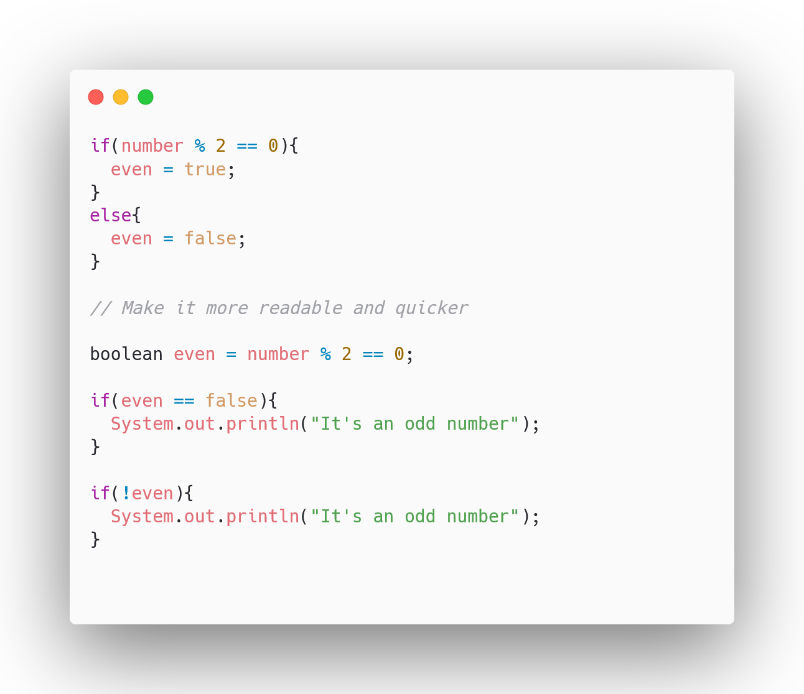
Pro tip:

Slide 42
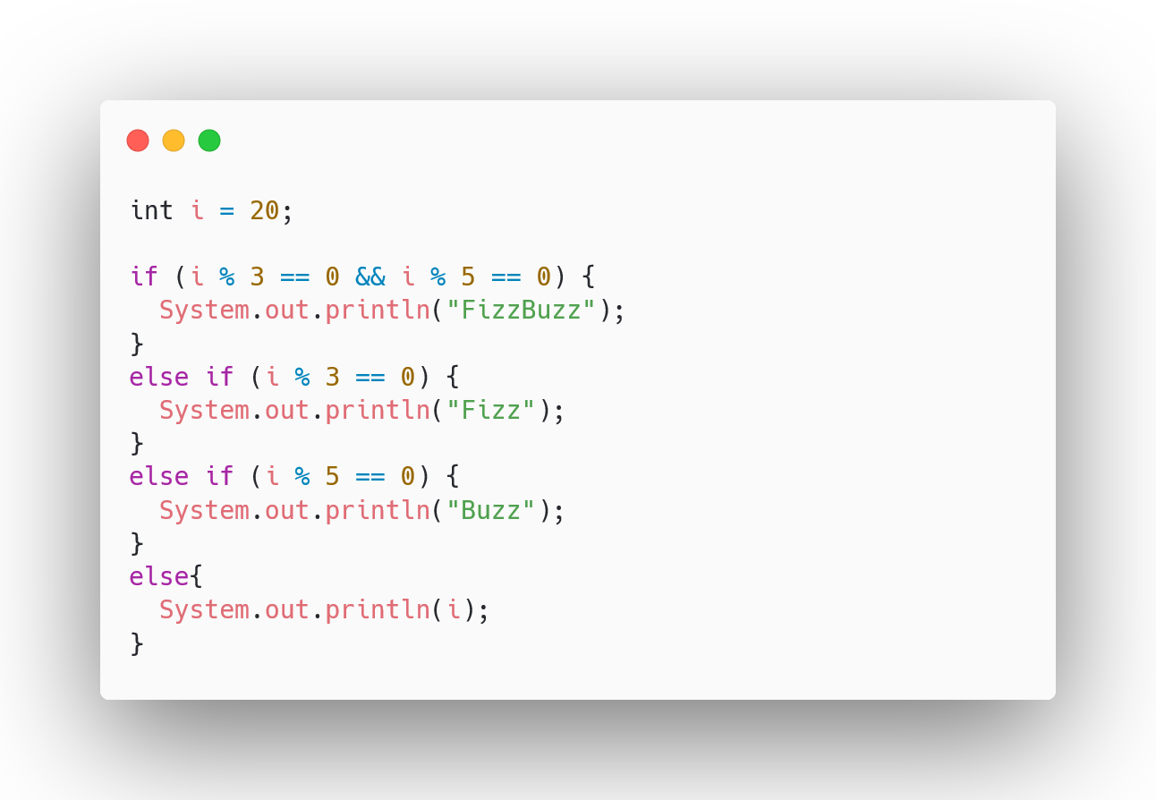
If-else case practice: Fizz Buzz

Slide 43
Loops in Java

Slide 44
What are the main goals using loops
Loop can be defined as one of the basic logical structures of computer programming. Defining loops in codes allows computers to perform particular tasks repeatedly.

Slide 45
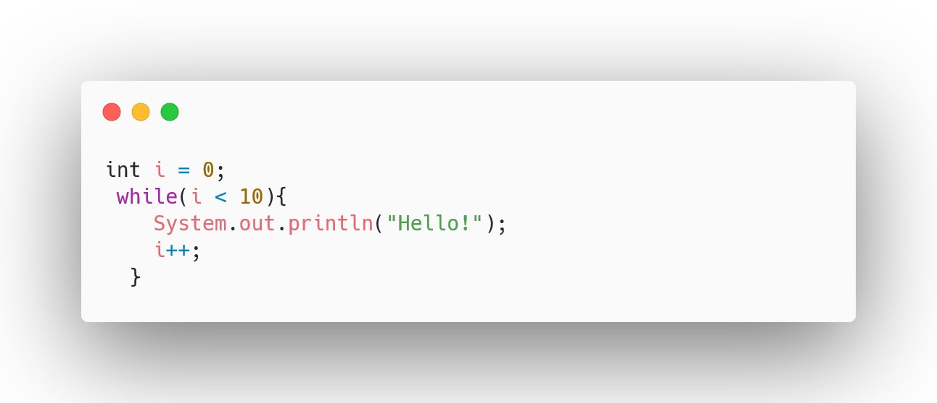
While loop
Used to repeat a specific block of code an unknown number of times, until a condition is met

Slide 46
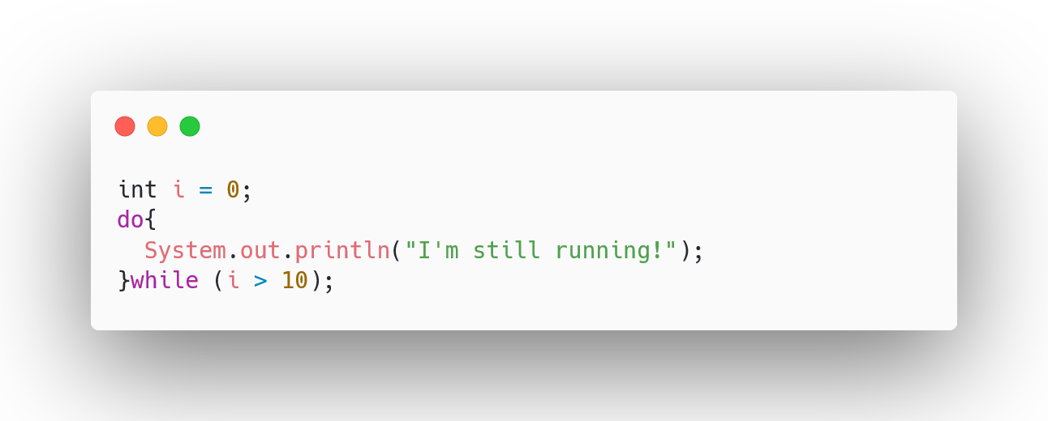
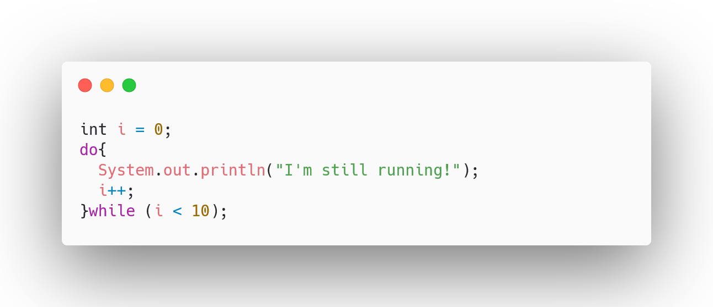
Do-while loop
The do…while in Java is a loop statement used to repeat some part of the code till the given condition is fulfilled.

Slide 47
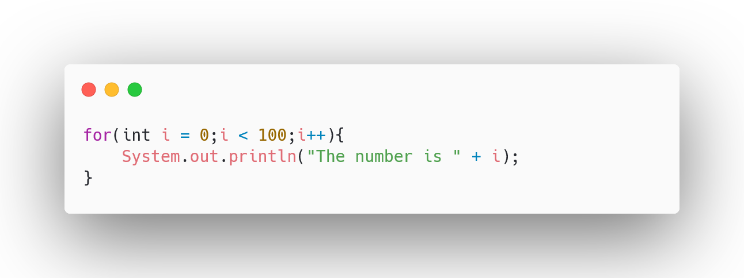
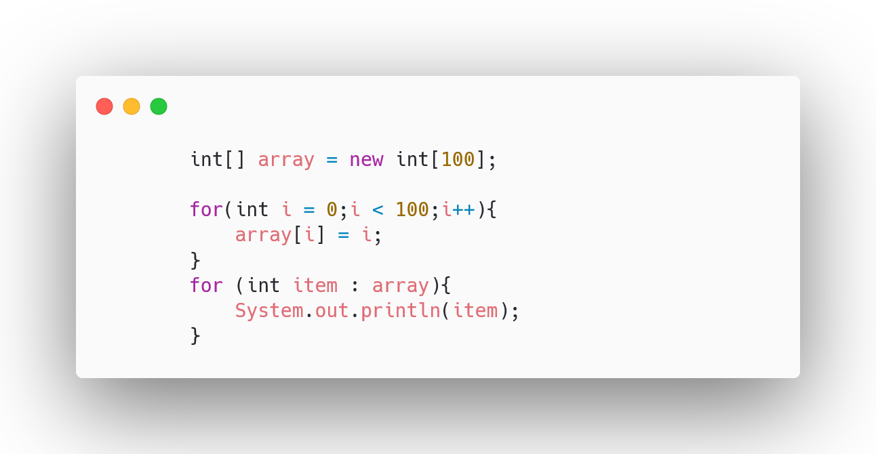
For / Foreach loop
In Java, a for loop is a control flow statement used to repeatedly execute a block of code a specified number of times. It is sometimes used for collections or arrays to loop through the items. (Foreach makes it more easier)
The for loop provides a more compact way to express the repetitive execution of code compared to a while loop.

Slide 48
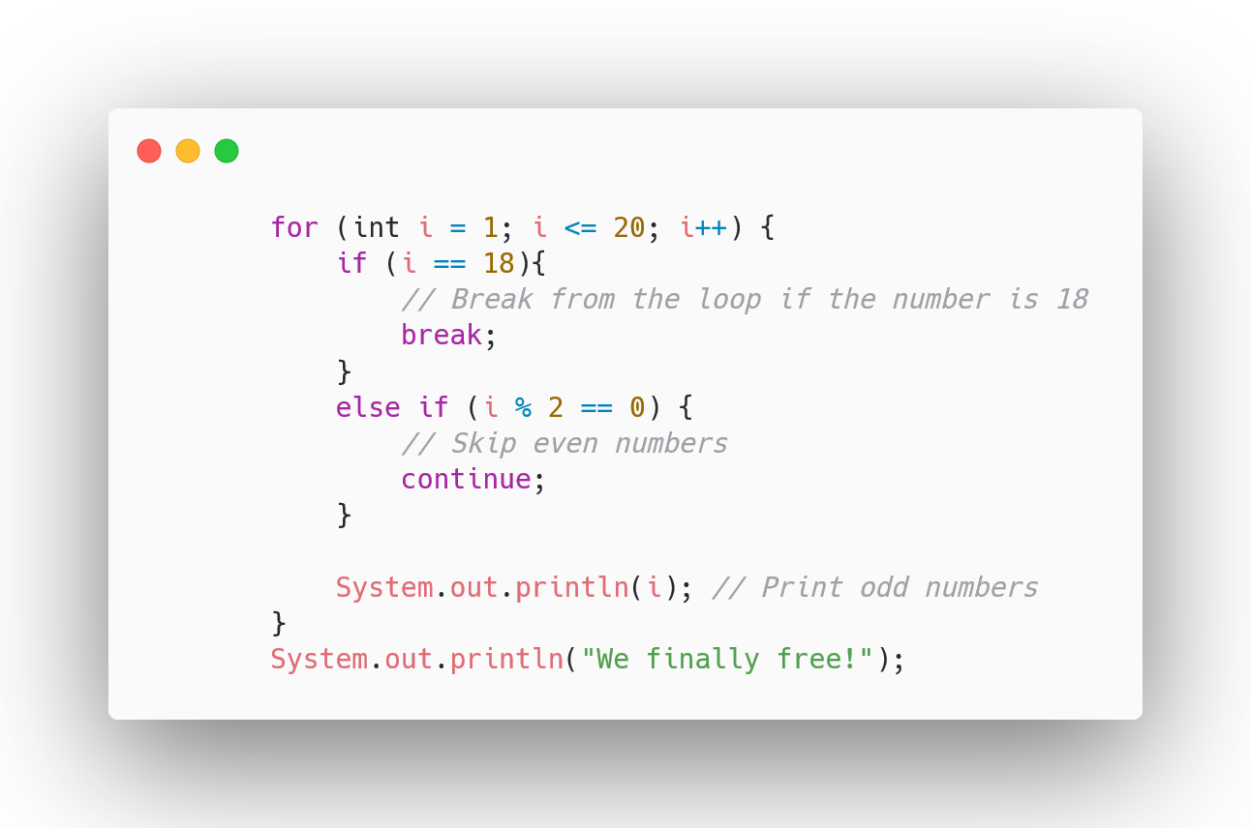
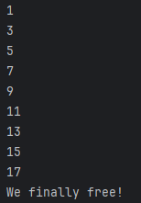
Break and Continue in Java
In Java, the break statement is used to terminate the execution of a loop prematurely. (We saw that earlier in the switch statements topic also)
In Java, the continue statement is used within loop constructs to skip the remaining code in the current iteration of the loop and proceed to the next iteration.

Slide 49
Street smart knowledge about loops
Prefer a while loop when the condition has nothing to do with a collection/array and does not require a set number of iterations.
Prefer a foreach or a for loop whenever the loop is related to a collection or array.
Prefer a foreach instead of a for loop whenever you don't need the indexer.
Prefer a for loop when you want to loop over a range of times and there is no collection, or when you need the indexer of the collection within the loop body.

Slide 50
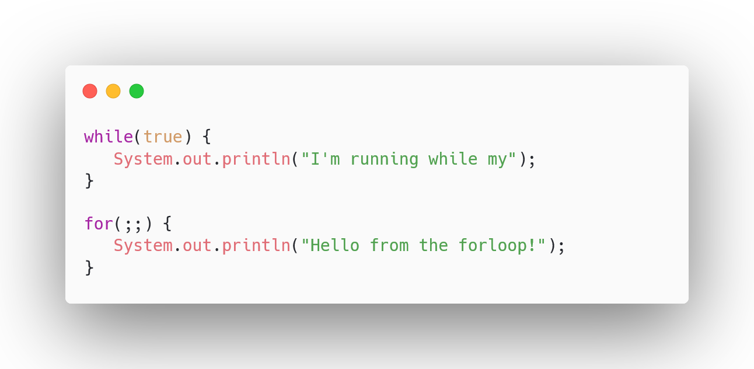
Some note about the while and for loop
It is used to create an infinite loop, which means that the loop will continue to run indefinitely, or until some other condition within the loop is met that causes it to exit.

Slide 51
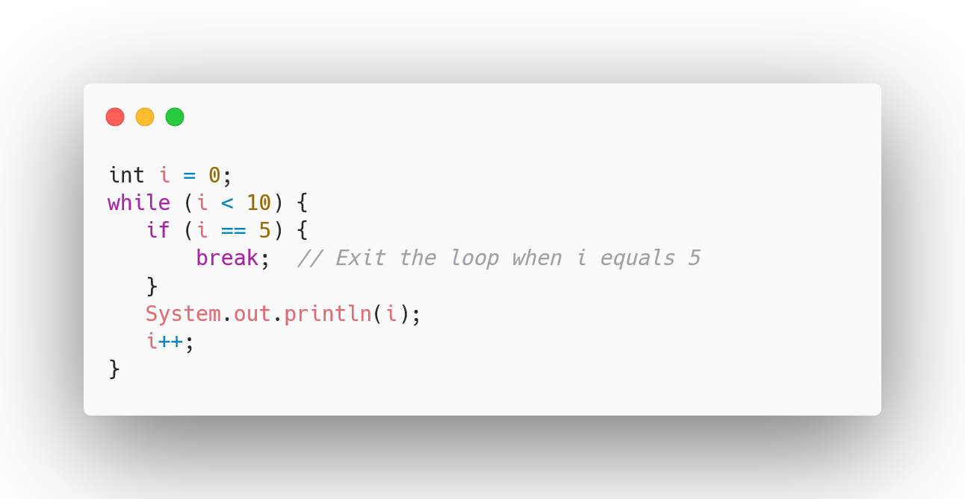
Break
In programming, the break statement is used to exit a loop prematurely before it reaches its natural termination condition. It is used in for, while, do-while loops.

Slide 52
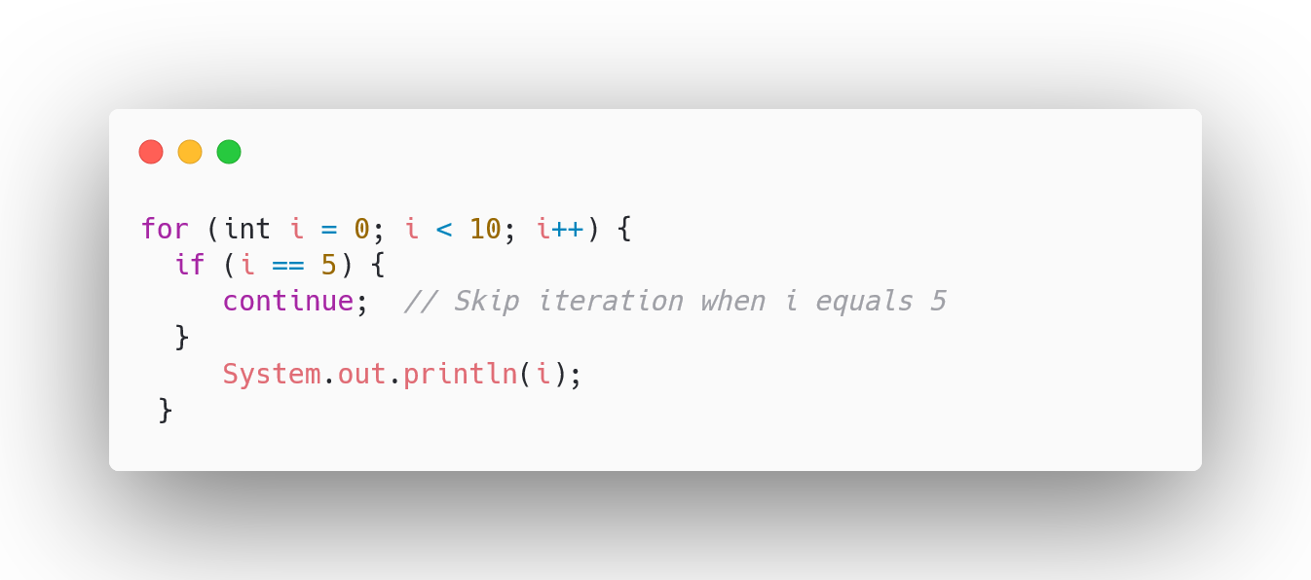
Continue
In programming, the continue statement is used to skip the current iteration of a loop (e.g., for, while, or do-while) and proceed to the next iteration.

Slide 53
Object Oriented Programming

Slide 54
Functions and procedures
Function: A function returns a value as its result. When you call a function, it performs some operations and typically returns a value that can be used in expressions or assigned to variables.
Procedure: A procedure, also known as a subroutine or void function, does not return a value. It is used to perform a specific task or set of operations without producing a result that can be used in expressions.
So it means procedures are used for performing tasks, while functions are primarily used for computation and data transformation. (return value / void)

Slide 55
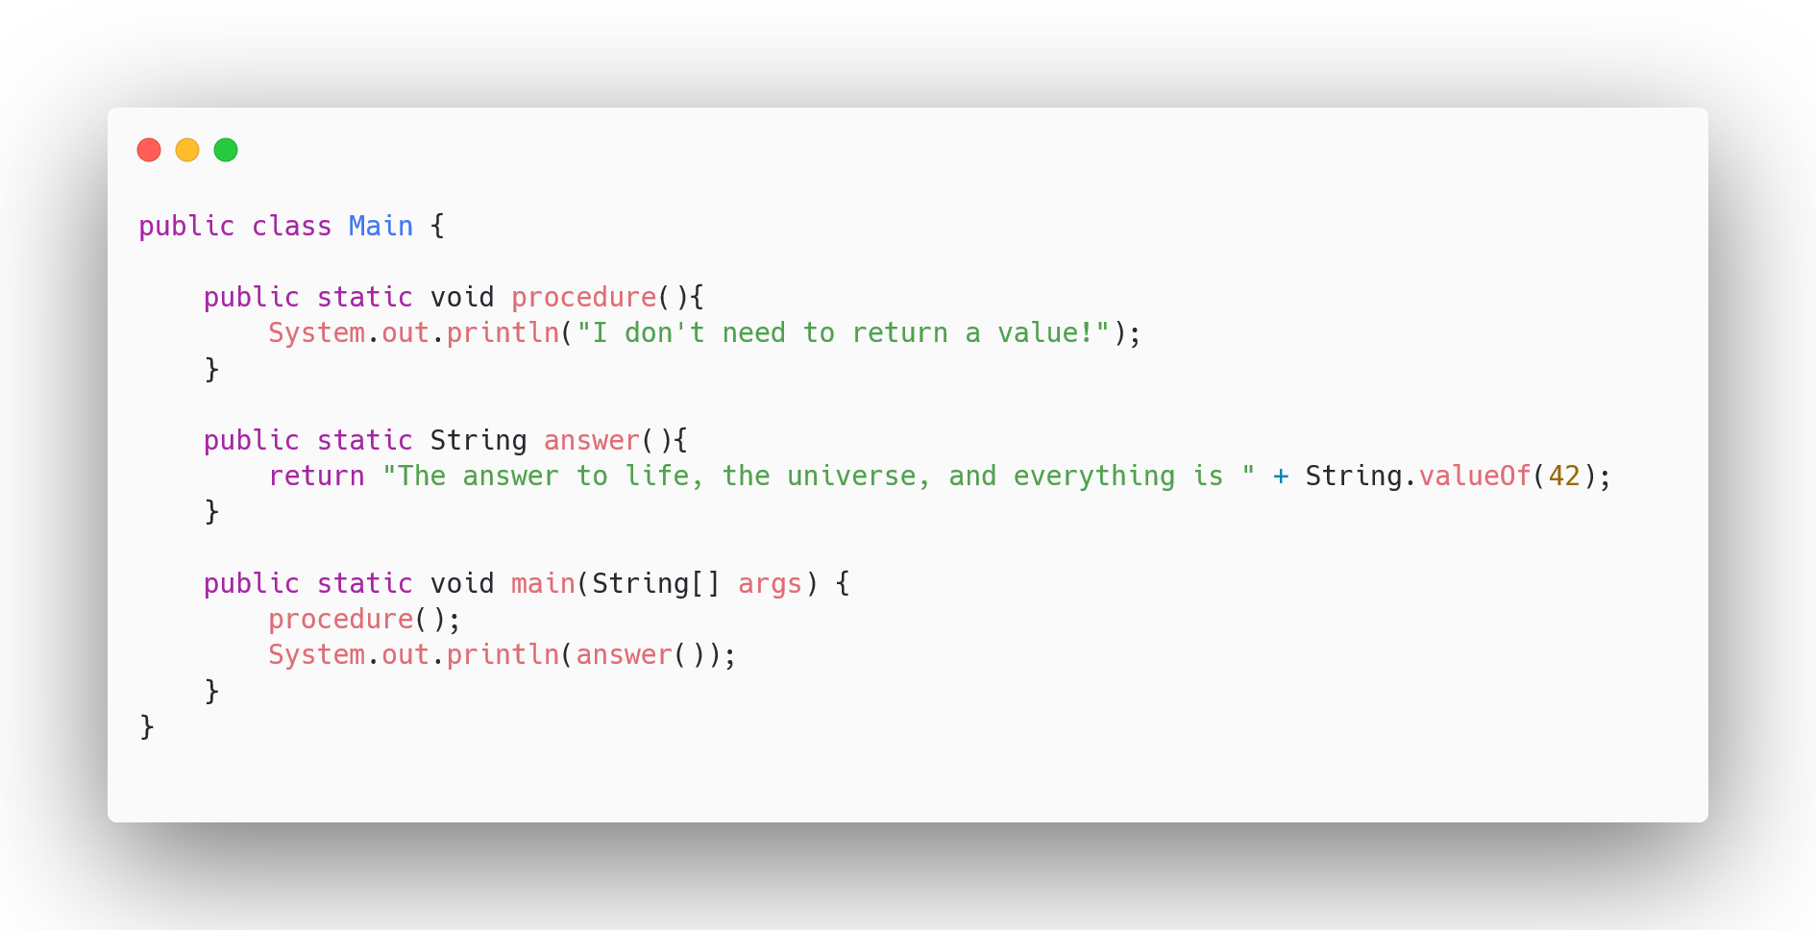
Functions and procedures

Slide 56
Fundamental concepts of OOP:
Abstraction
Encapsulation
Inheritance
Polymorphism

Slide 57
Object
A thing from the real world
It could be a card, a bus, an airplane or a book…
But it’s not physical as you might expect
An appointment, a reservation, a date, an account
A thing that you want to store and process data about
Another name for an object is an entity!

Slide 58
Abstraction (first fundamental)
The goal is to simplify the reality
A person is an object, it’s unlikely that you want to store all the data from a person. Rather we use the data that is important in our application, like height, name, occupation, date of birth.
The tasks that we want to perform with those data, so all in all to process the data.

Slide 59
Class
To create objects programmatically we need a class
A template for creating objects, code written by a programmer like you
Attributes describe the object, sometimes you can find references that states that these are the fields of an object, because they contain data.
Most programmers know them as properties or props.
Operations are actions that can be done to, or performed by the object, more commonly known as methods.
Methods are programs within the class, either procedures or functions.
A class sometimes is referred to be a type, each object is an instance of a class in the computer's memory.
Creating an object from a class a lot of time referred instantiation

Slide 60
Class
Once these objects have been created, their properties can be assigned values, making the object type as an unique entity
Each property is defined in the class by a property procedure which may include a code to validate a property value while it’s being assigned.
This helps to ensure the integrity of the data.
The property values that have been assigned to an object are collectively known as a state of an object
It’s also possible to assign values to an object while an object being instantiated, by special method called new (constructors)

Slide 61
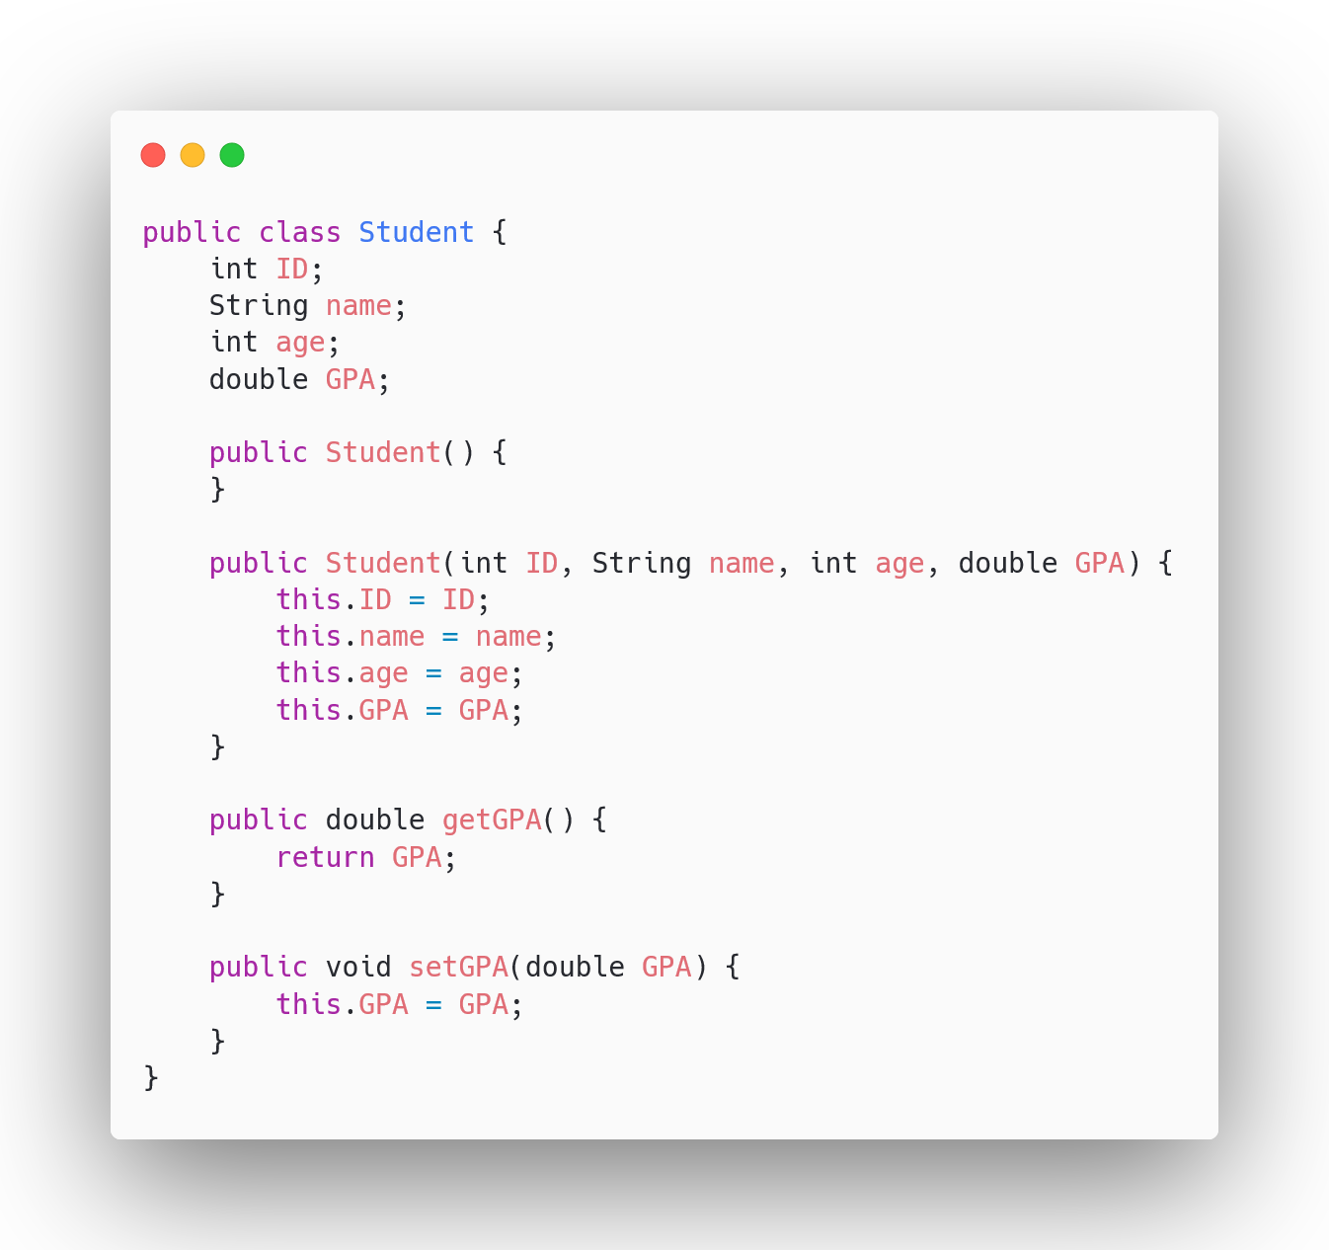
Class in practice

Slide 62
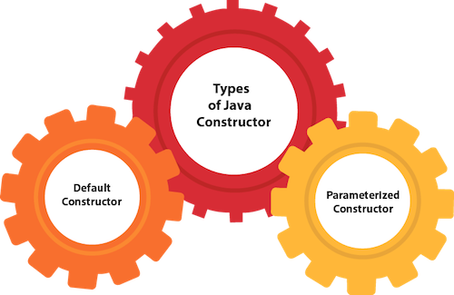


Constructors
In Java, a constructor is a special type of method that is used to initialize objects.

Slide 63
Encapsulation - (second fundamental)
Hiding data and complexity from programmers and programs
It’s often referred as information hiding, because the data contained within an object and the functions that manipulate the data, are bound together, and there for safe from outside interference.
In software development for example some senior programmers write the classes for the junior programmers, but they don’t have to know what is going on in the class. All they need to know, the name of the class, the properties and the methods that are available. All in all they need to know the interface of the class. The implementation can remain a mystery.
This really simplifies the use of objects
Helps to ensure the data and operations are encapsulated within are safe.

Slide 64

this keyword
The this keyword refers to the current object in a method or constructor.
In Java, this is a keyword that refers to the current instance of the class. It is often used within the class's methods and constructors to refer to the current object.

Slide 65


Getters / Setters
Getters and Setters are methods used to access and modify the private fields of a class, providing a way to encapsulate the internal state of an object.
This encapsulation is a fundamental principle of object oriented programming and helps in controlling access to the fields of a class.

Slide 66
Inheritance - (third fundamental)
A class can derive its methods and properties from another class
Inheritance can result a hierarchy of classes.
Base/Super class / sub classes

Slide 67
Inheritance in practice
Vehicle
Car
Plane
Bus

Slide 68
Polymorphism - (fourth fundamental)
A class can implement an inherited method in its own way
Polymorphism is considered one of the important features of Object-Oriented Programming. Polymorphism allows us to perform a single action in different ways. In other words, polymorphism allows you to define one interface and have multiple implementations.

Slide 69

Polymorphism in practice

Slide 70

Override
In Java, method overriding is a powerful technique that allows subclasses to provide a specific implementation of a method that is already defined in its parent class.

Slide 71
Recap all the things
Abstraction: To simplify the reality and focus only on the data and processes relevant to the application being built
Encapsulation: Data and the programs that manipulate those data are bound together and their complexity is hidden
Inheritance: A class can derive methods and properties from another class, resulting in a hierarchy of classes
Polymorphism: Different subclasses of the same superclass, can implement their shared interface in different ways

Slide 72

Access Modifiers
In Java, access modifiers are keywords used to set the visibility or accessibility of classes, methods, and other members within a program. There are four main access modifiers in Java
Helping to enforce good programming practices such as information hiding.

Slide 73

Public
Members declared as public are accessible from any other class. This is the least restrictive access level. It can be accessed from anywhere

Slide 74

Private
The access level of a private modifier is only within the class. It cannot be accessed from outside the class.

Slide 75

Protected
When methods and data members are declared protected, we can access them within the same package as well as from subclasses.

Slide 76
Default (It’s good to know for interviews)
The access level of a default modifier is only within the package. It cannot be accessed from outside the package. If you do not specify any access level, it will be the default.

Slide 77

Static
Some class fields may be marked with the static modifier.
The variables that marked static are called class variables.
This is in contrast to other non-static member variables, which are called object variables.
Object variable means that, when several objects are instantiated, each object gets a distinct copy of the variable and can manipulate them independently.

Slide 78

Strings and Strings…
The Java String class is a fundamental class that represents character sequences. It provides a rich set of methods for manipulating strings, making it a powerful tool for working with text in Java programs.
Here are some of the most useful String methods.

Slide 79


Final modifier
With variables, the final keyword indicates that the variable's value cannot be reassigned after initialization. This typically applies to constants, such as mathematical values or predefined constants in classes.
When applied to methods, the final keyword prevents subclasses from overriding the method. This is useful when the method's implementation is considered complete and should not be modified in subclasses.

Slide 80
Interfaces
In Java, an interface is a blueprint or a template for classes. It defines the methods and properties that a class must have, but it does not provide the implementation details.
In summary, interfaces are powerful tools for designing modular, reusable, and maintainable code in Java. They promote abstraction, encapsulation, and polymorphism, making them essential for building robust and extensible software systems.

Slide 81
Collections

Slide 82

ArrayList
In Java, an ArrayList is a class that implements the List interface and represents a dynamically resizable array. Unlike traditional arrays, which have a fixed size, ArrayLists can grow or shrink as needed to accommodate new elements or remove existing ones. This makes them a versatile and efficient data structure for storing collections of objects.

Slide 83

Maps
In Java, a Map is an object that stores key-value pairs, where each key is unique and mapped to a single value. Unlike arrays or lists, which store elements in a sequential order, maps are used to associate elements based on their unique keys. This makes them ideal for scenarios where data is accessed or updated using specific identifiers.

Slide 84
Command line arguments

Slide 85


Command line argument
In computer programming, a command-line argument is information that is passed to a program when it is run through the command line or terminal.
You can provide additional input to the program by including command-line arguments after the program's name.

Slide 86
Exception handling and debugging

Slide 87
try catch and finally
In Java, try-catch blocks are used to handle exceptions, which are unexpected events that can occur during program execution.
An exception indicates that something went wrong, and if not handled properly, it can cause the program to crash.
The try block contains the code that might throw an exception, and the catch block contains the code that will be executed if an exception is thrown. The finally block is optional and will be executed regardless of whether an exception is thrown or not.

Slide 88

try catch finally example

Slide 89

Scanner class and exception handling
The Scanner class in Java is a versatile tool for reading input from various sources, including the console, files, and other streams. It provides a straightforward and efficient way to collect user input and parse it into various data types.

Slide 90
Thanks for your attention!

